Slide 1
Version Control
Git

Slide 2
What is Git?
Git is a free and open source distributed version control system designed to handle everything from small to very large projects with speed and efficiency.

Slide 3
Git Hosting
Git does not restrict access
You can use a remote repository hosting to restrict access
GitHub
BitBucket

Slide 4
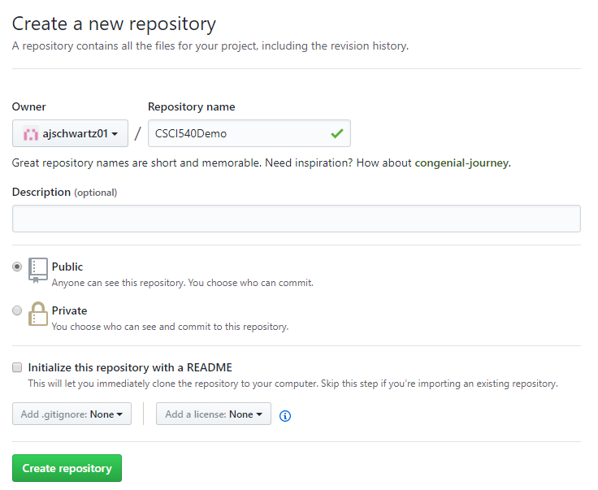
Create Remote Repository
Login to your github account and create a New repository

Slide 5
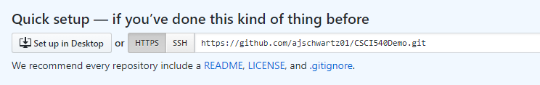
Create Remote Repository
This is your repository URL. You will need this.

Slide 6
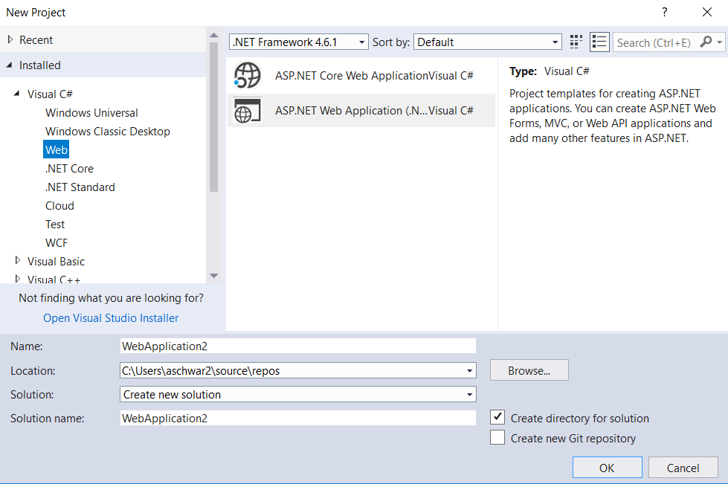
Creating a Git Repository
From a new project

Slide 7
Git and Visual Studio
There is a nice GitHub Extension for Visual Studio which can help simplify the process of checking code in and out.
https://visualstudio.github.com/

Slide 8
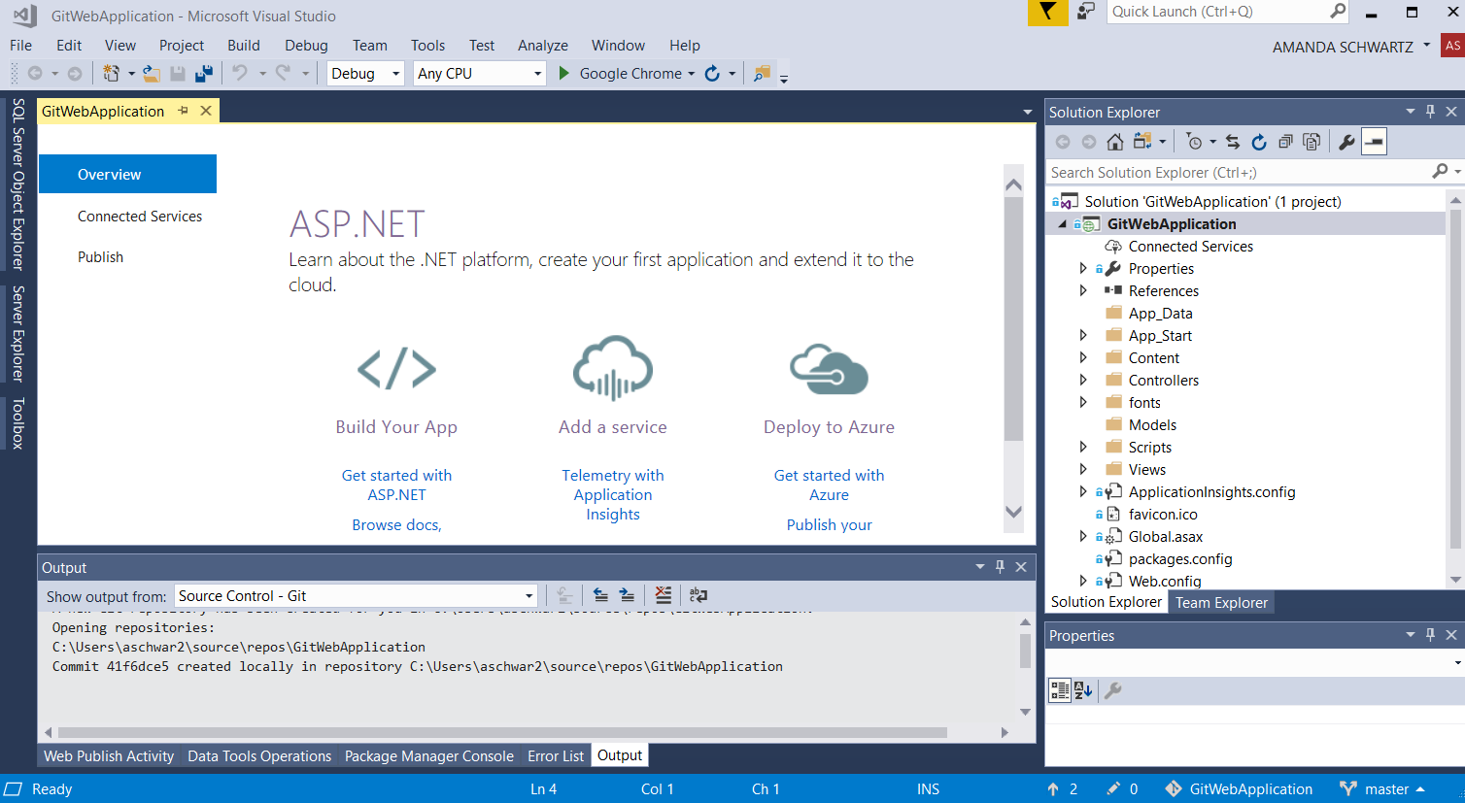
Create a Git Repository

Slide 9
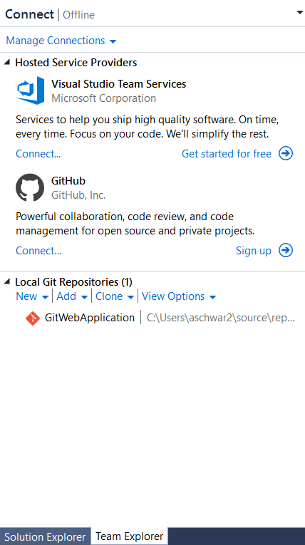
Pushing to Remote Server
Click on the Git repository in the bottom right (as shown in the previous slide)
Click Connect
(or sign up if you don’t have an account)
Log in to your account

Slide 10
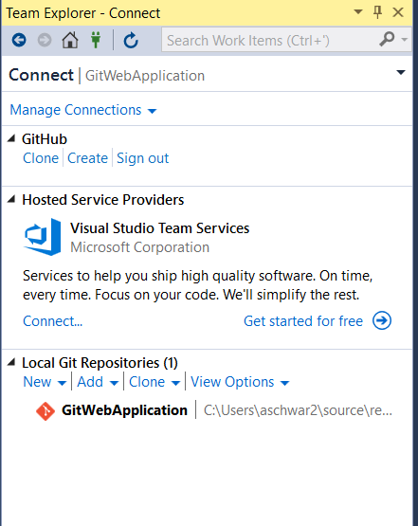
Pushing to Remote Server
After logging in, your view changes to the picture on the right

Slide 11
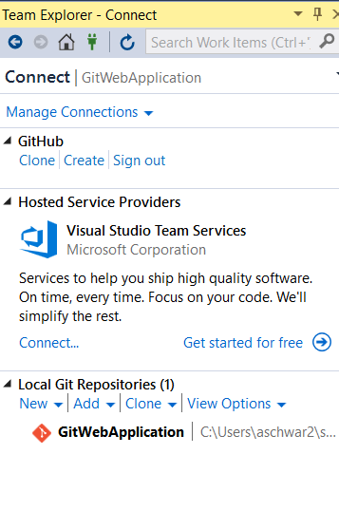
Pushing to Remote Server
Click the Home button (the house picture on the toolbar).

Slide 12
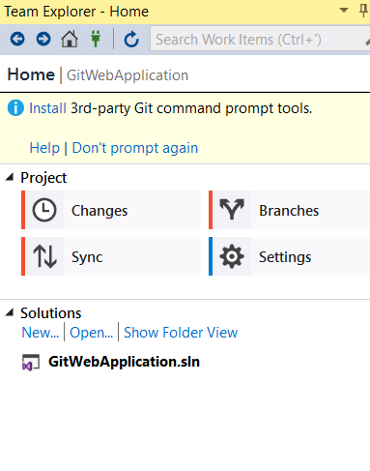
Pushing to Remote Server
Click Sync

Slide 13
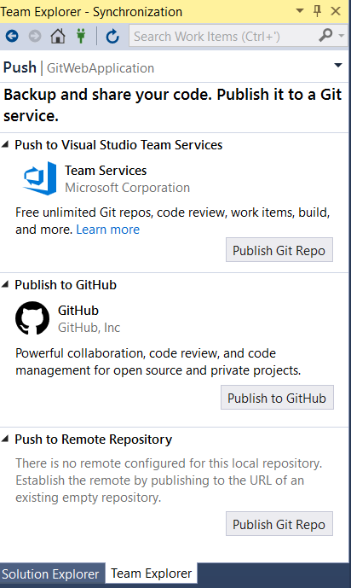
Pushing to Remote Repository
Click Publish to GitHub
Then click Publish

Slide 14
Repository Created
Log in to your Github account and see the repository is created there.

Slide 15
Making changes
Create a simple Person model
Scaffold the controllers and views (as demonstrated in class)

Slide 16
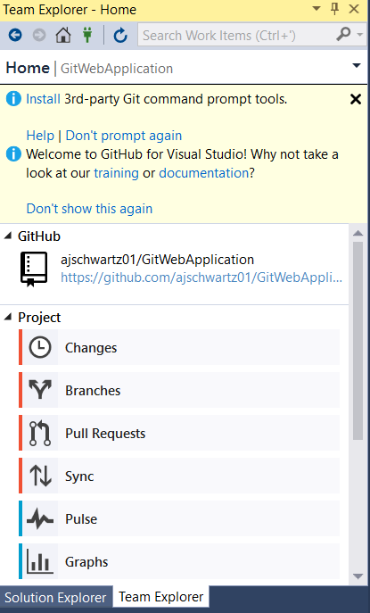
Committing Your Changes
In the Home view under Team Explorer, click on Changes.

Slide 17
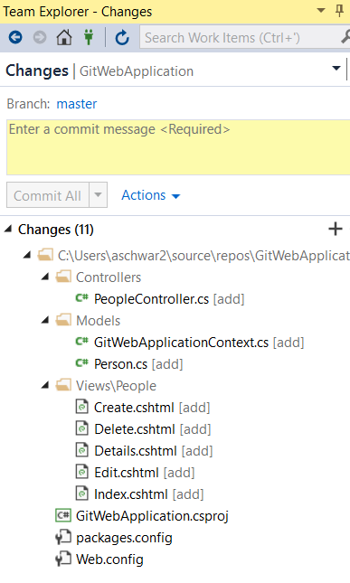
Committing Your Changes
Notice all the changes you made are listed there.

Slide 18
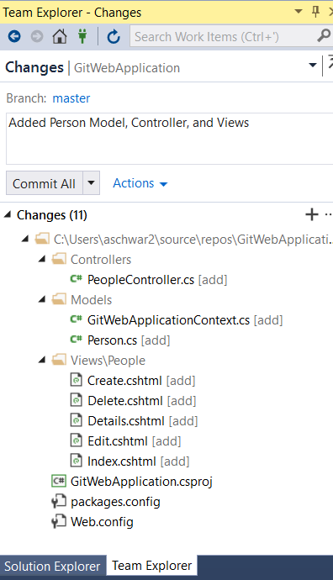
Committing Your Changes
Enter a comment, and click Commit All.

Slide 19
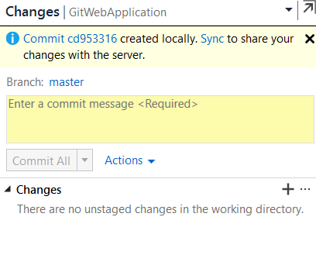
Committing Your Changes
Notice that was a LOCAL commit. You need to push your changes to the remote repository yet.

Slide 20
Pushing to Remote Repository
Click on the Sync link.

Slide 21
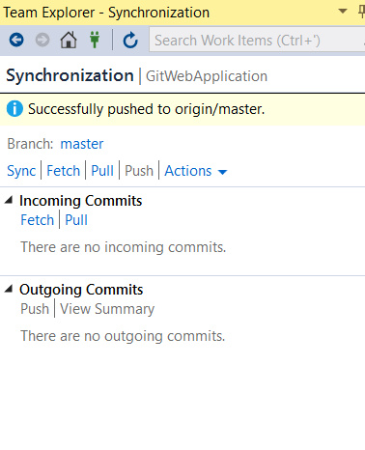
Pushing to Remote Repository
Click on Push.
Refresh the repository on github and see your changes there.

Slide 22
Cloning an Existing Project
Open Visual Studio but do not create a project.
Open Team Explorer, and click Clone.

Slide 23
Get other people’s changes
Open Team Explorer, and go to the Home view
Click Sync
Click Pull

